Slide 1
Introduction to
Data Analytics - BA780
Fall 2021
Lecture 01
Professor: Mohammad Soltanieh-ha

Slide 3
Back2BU
We will follow the guidelines provided by BU. Learn more at bu.edu/back2bu.
A few important highlights are listed below:
Follow all University health requirements.
Complete a symptom attestation through Patient Connect each day prior to going to campus, or, if you are a resident on campus, before leaving your room.
Follow any instructions from BU medical professionals if you report positive symptoms and are required to be tested for COVID-19
Isolate at your residence, if you are notified by BU medical professionals or by your own primary care provider that you have a positive result from testing. Contact your instructor ASAP.
In the classroom
If you are unable to show a green badge, you may be asked to leave class
You will be asked to put on your mask. Your mask should cover both your nose and mouth at all times.
Eating is not permitted in the classroom. Drinking is allowed only with a straw.

Slide 4
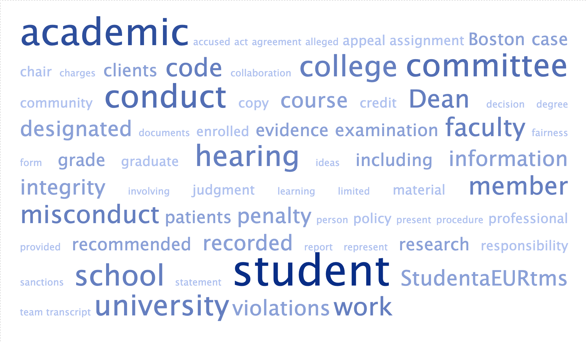
Academic Conduct Code
https://www.bu.edu/academics/policies/academic-conduct-code/

Slide 5
Student Feedback - BA775
Effectiveness of team project rating: 4.88 out of 5 (up from 4.77 in 2020)
Chance of contributing to the project: 83 answered yes (out of 84)
Positive feedback around the project
Great way to reinforce what was seen in the class
Great way to work with others
More time would have been good

Slide 6
Instructor’s Assessment - BA775
Final projects and presentations
Variety of the topics & 4 course goals
Advanced topics (advanced SQL & ML)
Great Slack participation - class participation can be better
Overall class learning

Slide 7
Ba780 vs. BA775
BA780 is purely focused on data munging and data analysis in python. BA775 was a “toolbox” course and covered a variety of concepts/tools
No more Qwiklabs, but DataCamp assignments remain
Please refer to the syllabus regarding the office hours as they have changed
We will do a lot of live coding in this course and many in-class exercises
This course has two primary books and reading is required

Slide 8

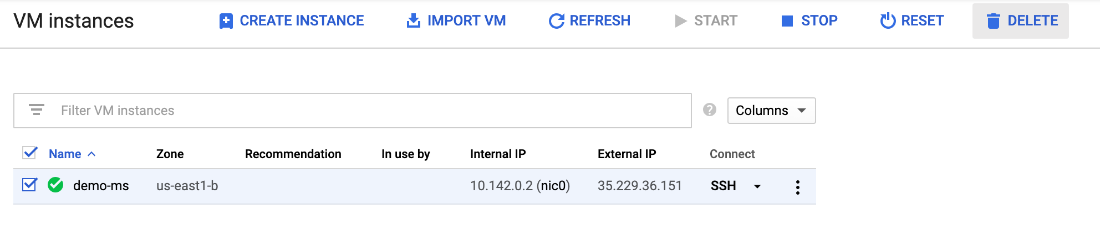
Terminate BA775 VM Instances
To avoid getting charged delete your instance:
From Compute Engine > VM Instances > select the instance you want to delete and press DELETE
Note: You should also delete BQ datasets that are not needed from BA775. Up to 10GB storage is free, so do it only if you have stored large tables.

Slide 9

Teaching Assistants
Paula Demacker -demacker@bu.edu Zhangcheng (Kristy) Guo - kguo@bu.edu
OH: Mon 9-10:30 a.m. OH: Thursday 6:30-8 p.m.
TAs will help with: 1) TA office hours 2) grading 3) moderating the Slack channel

Slide 10

Course Objectives
Essential elements of data wrangling (munging)
Data visualization
Data reporting
Fundamentals of data analysis

Slide 11
Course Logistics

Slide 12
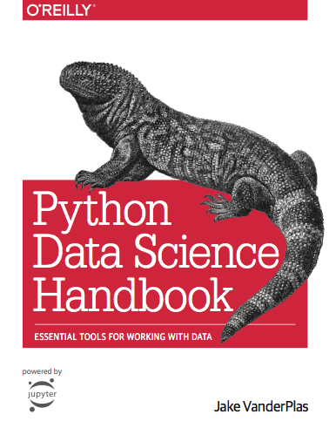

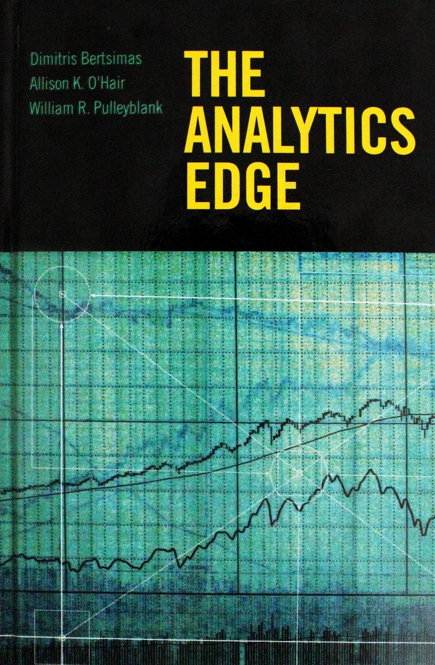
Books
Python Data Science Handbook: Essential Tools for Working with Data
1st edition: Free online access, Amazon link
A Whirlwind Tour of Python – A brief overview of programming in Python
Download a free copy here!
The Analytics Edge
Amazon, GitHub

Slide 13

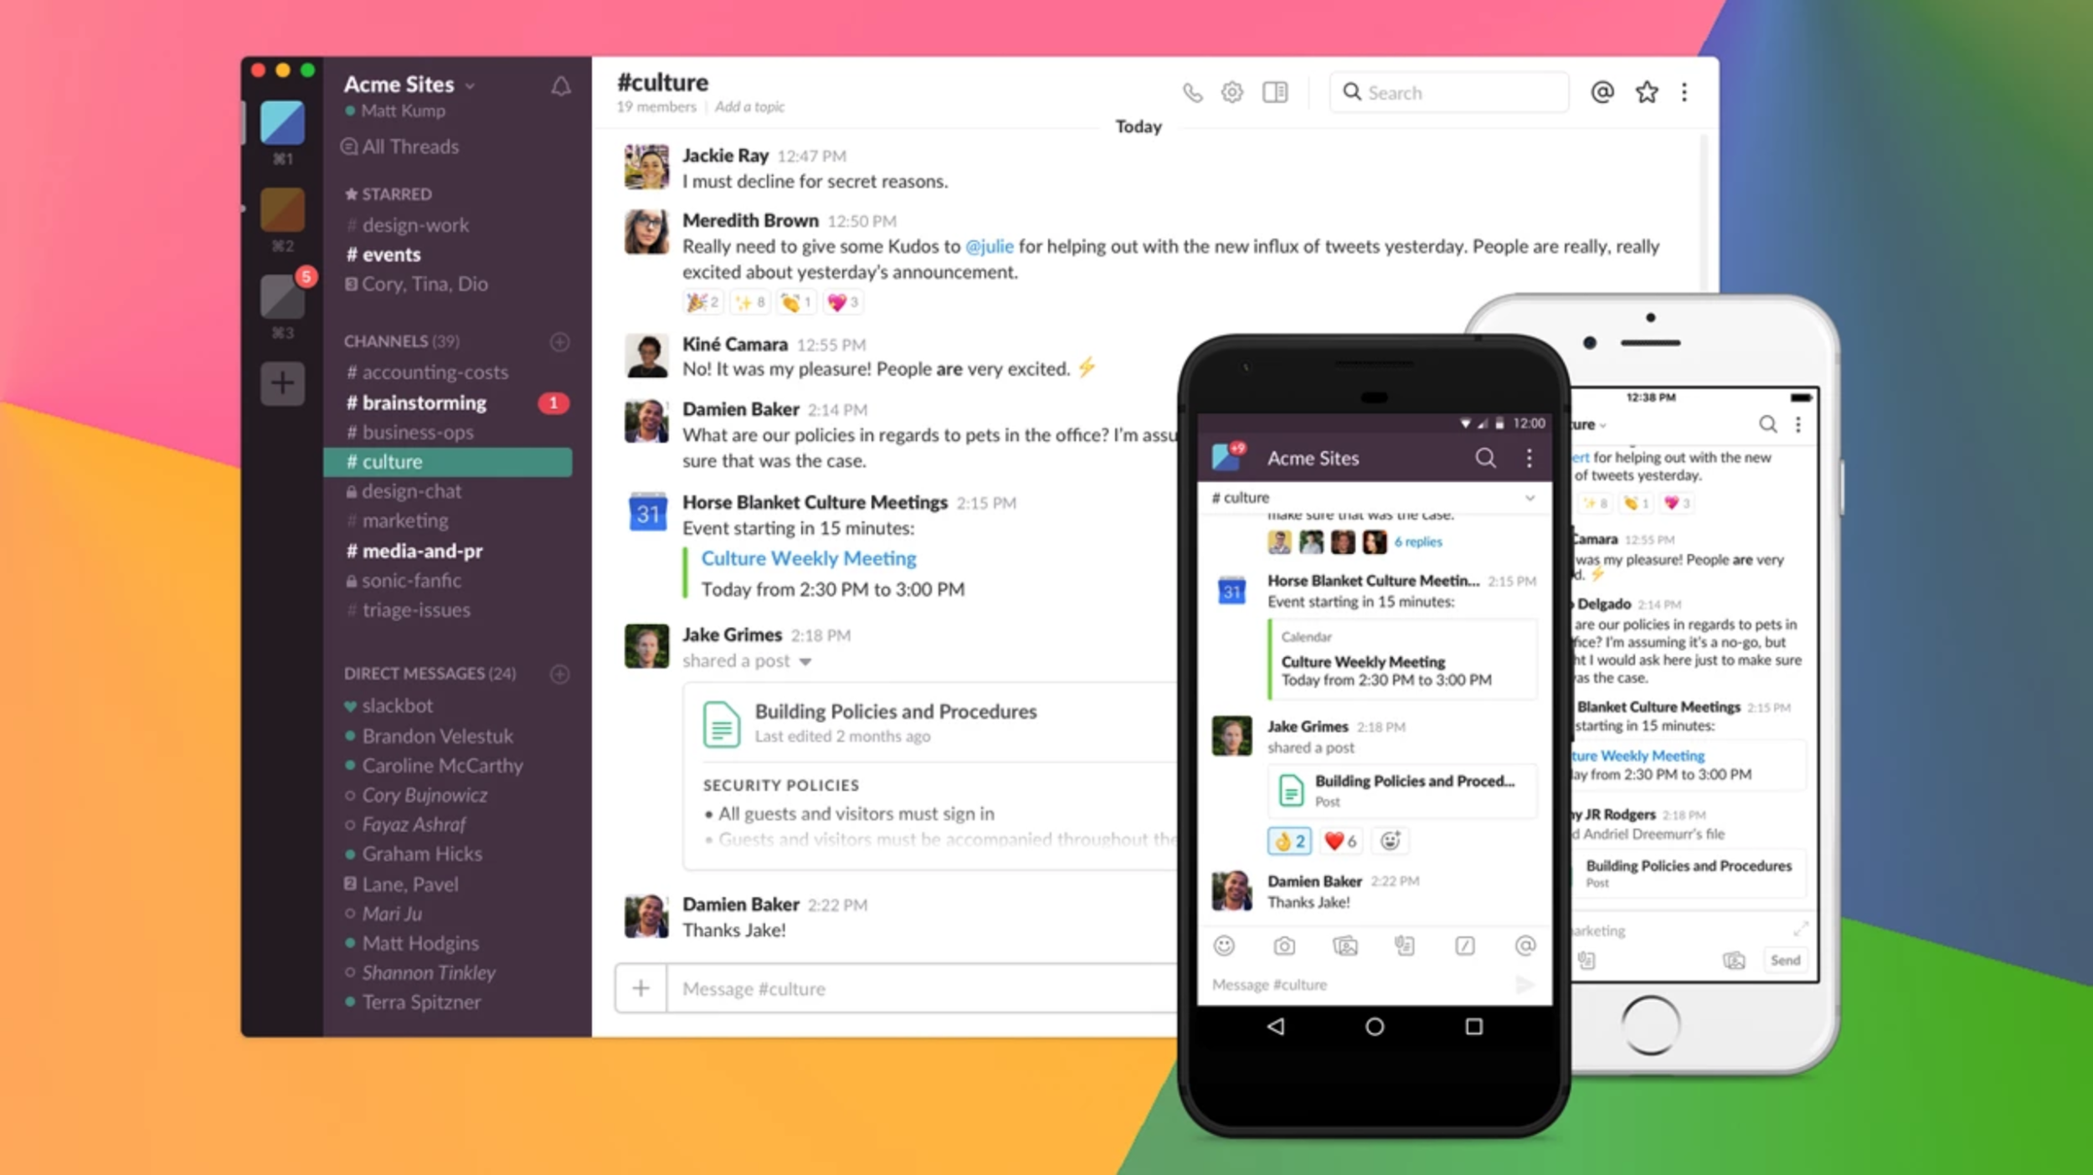
Slack Channel
ba780-fall21
You are encouraged to participate in Slack activities. Especially if you know the answer to someone else’s question; this will count towards your class contribution.
You will get a faster response from your TA compared to email.
Try to utilize DMs instead of emails.
During the office hours, TAs will go through the topics and questions that were asked in Slack.
Get the desktop and/or mobile app

Slide 14

Grading
Activity | Fraction of Grade
Class Contribution and Attendance | 15%
Individual Assignments | 15%
DataCamp Assignments | 15%
Team Assignment | 10%
Quizzes | 15%
Team Project | 30%

Slide 15

DataCamp
Use the following link to sign up and get access to DataCamp materials and assignments:
Both cohorts
* Make sure to use the above links and your BU email address. If you don’t see BA780 course listed it means I won’t see your assignments completed and you will lose grade.

Slide 16

Team Project
You will be working in a new team on a new project.

Slide 17
Quizzes
Some classes will include a 15-minute multiple-choice quiz. These quizzes will be directly related to the topics discussed in the previous 2 classes. Quizzes are open-book, and open-internet.
Quizzes are accessible through the course site.

Slide 18


Slide 19
Code + Data
Code and data are available on my GitHub repository(bit.ly/BU-BA780): https://github.com/soltaniehha/Intro-to-Data-Analytics
In order to clone this repo for the first use the following command:
git clone https://github.com/soltaniehha/Intro-to-Data-Analytics.git
In order to update the material after a new class use the following command within the Intro-to-Data-Analytics directory: git pull

Slide 20
Platforms to Run the Code on
Google Colab (preferred)
Vertex AI on Google Cloud (2nd preferred method)
Jupyter notebook on your laptop (won’t get support with potential issues)

Slide 21
Topics Covered in This Lecture
Introduction to the course
Setup
Coding Basics
Python overview
Syntax & semantics
Magic functions

Slide 22

Obtain $50 Credit
Follow the link sent to you on Slack to get the $50 coupon. Make sure to sign up with your BU email address and NOT your personal Gmail account.
Please DO NOT provide your credit card information for the purpose of this course!

Slide 23
Projects have three identifying attributes
Project ID
Project name
Project number
Globally unique
Need not be unique
Globally unique
Assigned by GCP but mutable during creation
Chosen by you
Assigned by GCP
Immutable after creation
Mutable
Immutable
Copyright Google LLC. For educational purposes in accordance with the terms of use set forth on the program Website.
Notes:
Each GCP project has a name and project ID that you assign. The project ID is a permanent, unchangeable identifier, and it has to be unique across GCP. While a Project ID will be generated automatically, you can edit it. However, this must be done while creating the new project though as it cannot be modified afterwards. In general, project IDs are made to be human-readable strings, and you’ll use them frequently to refer to projects.
On the other hand, project names are for your convenience, and you can change them. Note though that you can’t reuse the project name of a deleted project.
GCP also assigns each of your projects a unique project number, and you’ll see it displayed to you in various contexts, but using it is mostly outside the scope of this course.
As you work with GCP, you'll use these identifiers in certain command lines and API calls.

Slide 24
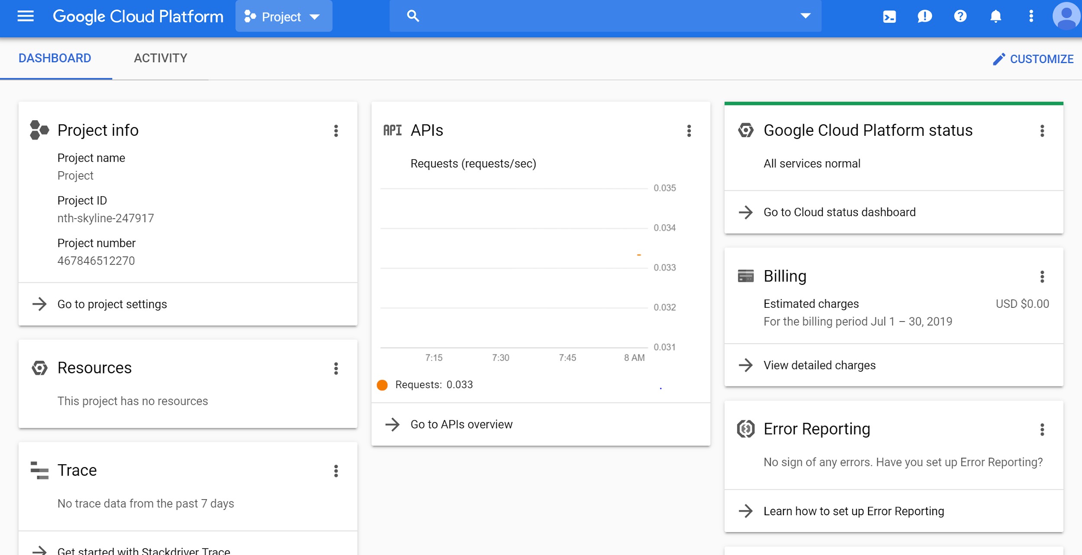
Creating a project
http://www.console.google.com
Copyright Google LLC. For educational purposes in accordance with the terms of use set forth on the program Website.
Notes:
To create a project, click on the name of the current project in the upper left portion of the screen.

Slide 25
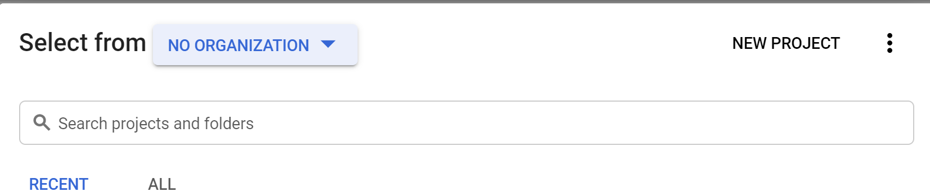
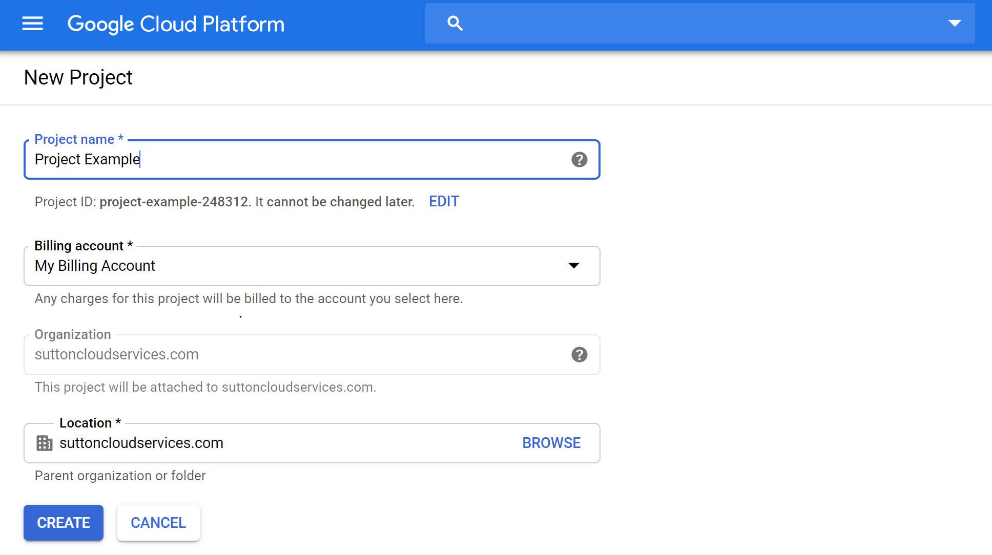
Creating a project
Copyright Google LLC. For educational purposes in accordance with the terms of use set forth on the program Website.
Notes:
A list of all current projects will be displayed. Select the New Project option on the right-hand side.
When the New Project screen is displayed, give your project a name. You have the option to use the auto-generated project ID, or create your own by clicking the Edit option. Project IDs must be globally unique. Select the appropriate billing account and organization and then click Create.

Slide 26
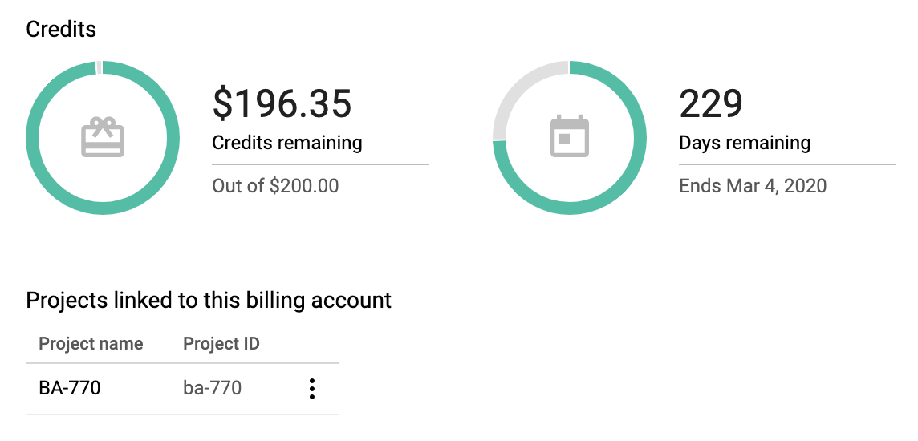
Billing Account
Login: https://console.cloud.google.com
Set up a project
Give the project a name; something like BA780
From Google Cloud Platform menu go to Billing > Go to linked billing account (if you have more than one) > Account management.. Make sure that you see your project name under the $50 coupon

Slide 27
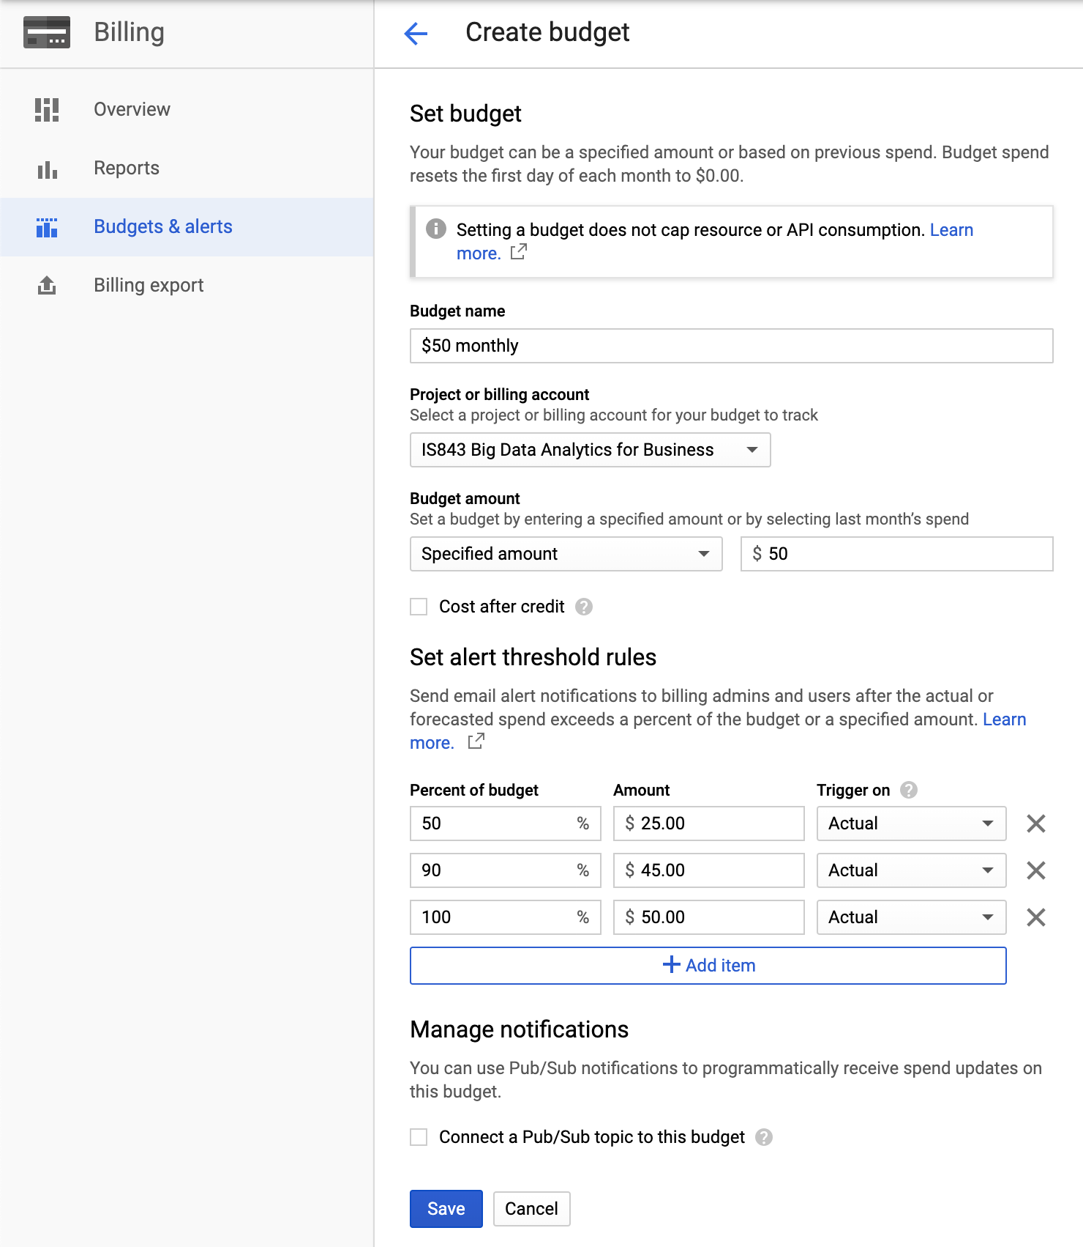
Budgets and Alerts
Go to Billing > Go to linked billing account > Budgets and alerts > Create a budget
Set the followings:
Budget name
Budget amount (E.g. $20/month)
Percent of budget to receive notifications

Slide 28
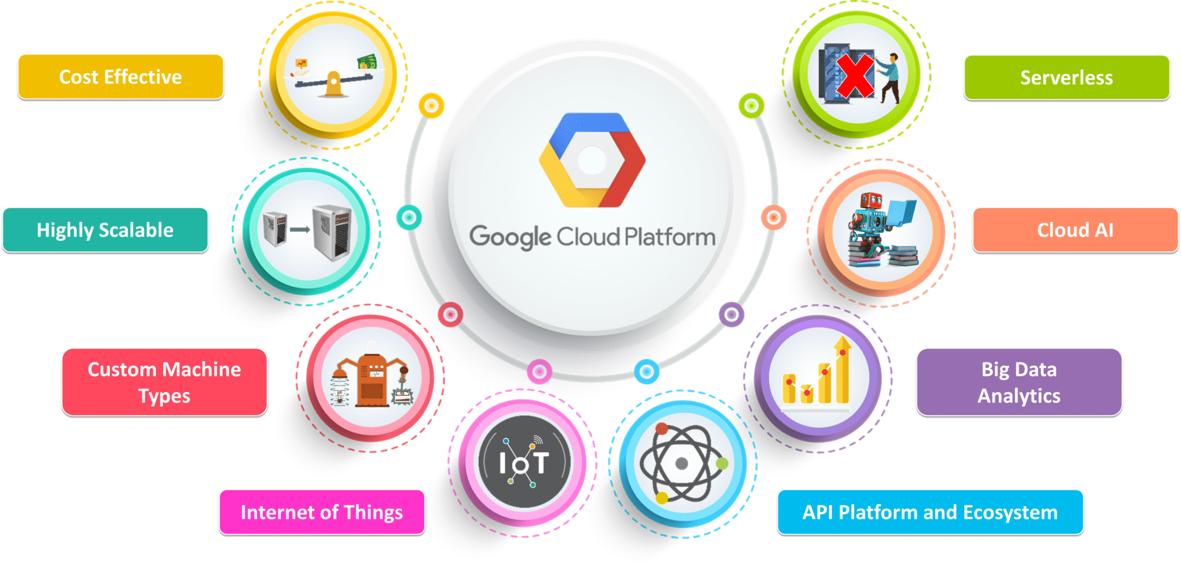
Why Cloud? (Why Vertex AI?)

Slide 29


DEMO
Setting up with Colab

Slide 30
DEMO
Setting up an Vertex AI instance
& Git setup

Slide 31

Moving to notebook(s)...
Pre-work: 00-Python-Basics folder
And corresponding exercise notebooks.
Colab link: https://colab.research.google.com/github/soltaniehha/Intro-to-Data-Analytics/

Slide 32

Discussion: Analytics Edge
Predicting Wine Quality (Chapter 1). Slides can be found here.

Slide 33
Moving to notebook(s)...
01-Introduction.ipynb
02-Python-Syntax-and-Semantics.ipynb
03-Magic-Commands.ipynb
And corresponding exercise notebooks.
Colab link: https://colab.research.google.com/github/soltaniehha/Intro-to-Data-Analytics/

Slide 34

Activity
DataCamp
Python Data Science Toolbox (Part 1)
1.1 Writing your own functions
1.2 Default arguments, variable-length arguments and scope
1.3 Lambda functions and error-handling
Due Tuesday - 09/07 @ 9:30 A.M.
Introduction to Data Science in Python
2.1 Getting Started in Python
2.2 Loading Data in pandas
Due Thursday - 09/09

